Slide 1
Refugee Nurses of Australia
STANDARDS OF PRACTICE

Slide 2
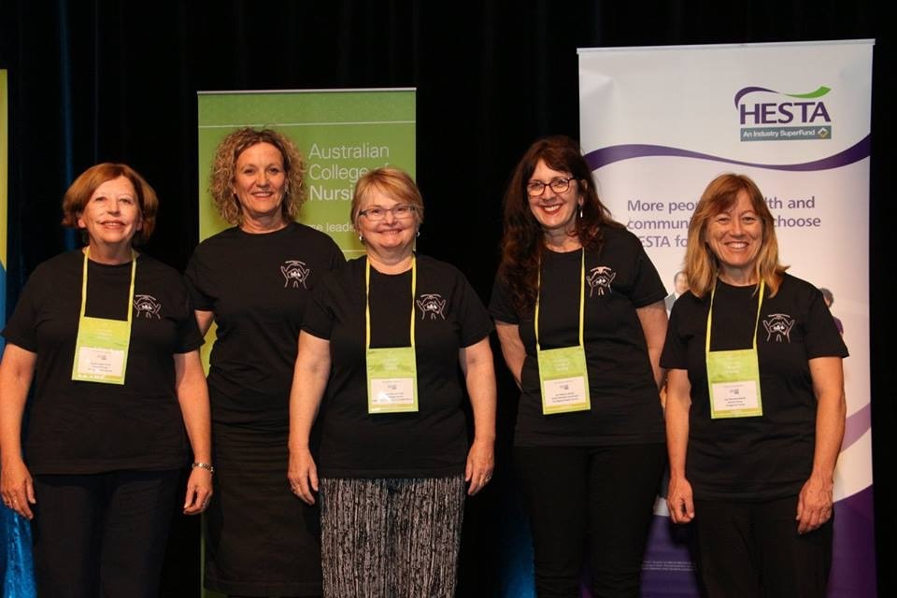
REFUGEE NURSES OF AUSTRALIA - RNA
Launched in October 2016
Steering Committee senior nurses across Australia
Provide a professional platform for nurses working in refugee health

Slide 3
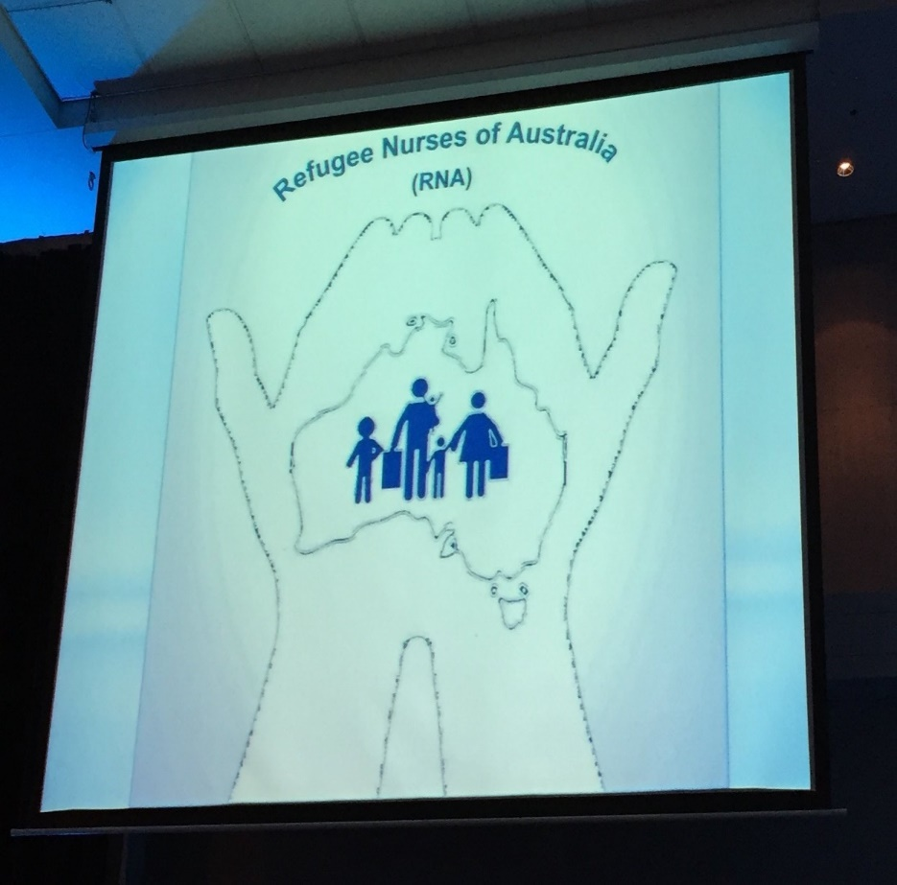
RNA
Provide a forum for the exchange of information and resources between refugee health nurses and other relevant stakeholders across Australia.
Promote best practice in refugee health nursing through quality improvements, professional practice and evidenced based research
Provide leadership in the development of a national refugee health nurse clinical practice framework including the scope of practice, credentialing and models of care.
Advocate for refugee and asylum seeker issues.

Slide 4
RNA Steering Committee
Bronwen Blake – NSW
Lisa Clements – ACT
Sue Dunford - SA
Sandy Eagar – NSW (Chairperson)
Michele Greenwood - NSW
Meryl Jones – QLD (Webmaster)
Brenda Kamau –WA
Lou Leol - TAS
Lindy Marlow – VIC
Leeanne Schmidt – QLD (Secretariat)
Irene Simonda -NT
Merilyn Spratling – VIC
Jan Williams - SA

Slide 5
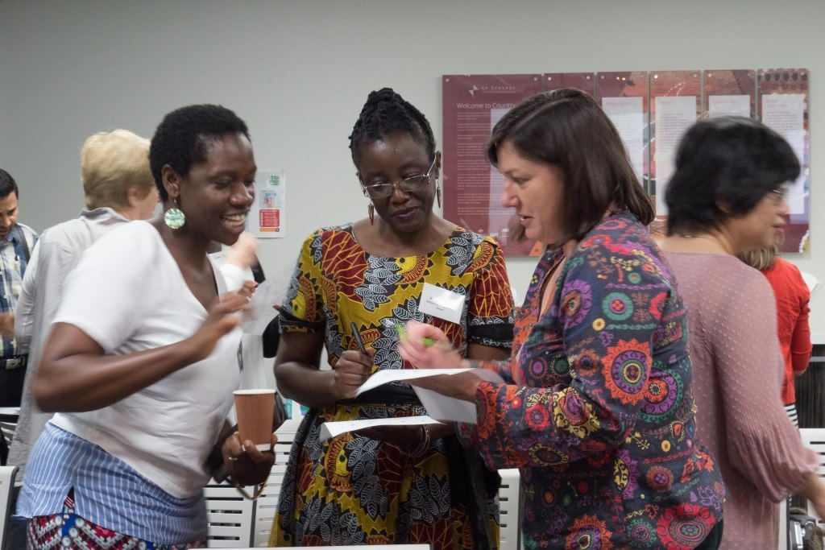
RNA FORUM 2017
60 Refugee Health Nurses (RHN)
Competency Framework session and brainstorm
What do you do as a refugee health nurse?
What skills do you need to work effectively with refugees?

Slide 6
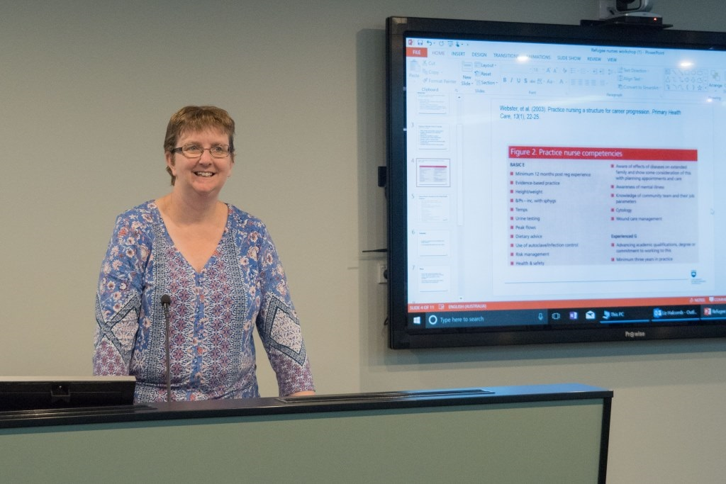
COMPETENCY FRAMEWORK
Chaired by Prof Liz Halcomb
Explored major themes:
Professional practice
Nursing Care
Environment
Politics

Slide 7
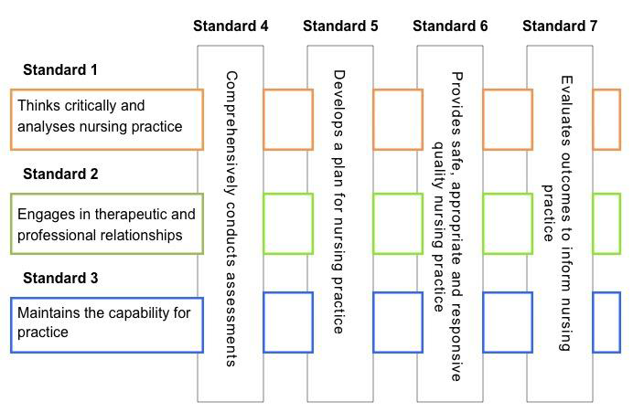
STANDARDS OF PRACTICE

Slide 8
STANDARDS OF PRACTICE
A refugee health nurse is a registered nurse who practices within a variety of clinical environments that uses a primary health care model underpinned by the philosophy of trauma informed care. Refugee health nurses (RHNs) acknowledge the dynamic contemporary political environment and thus advocates and defends the rights of the individual, family and community. RHNs deliver care that is culturally informed, inclusive, sensitive and safe.

Slide 9
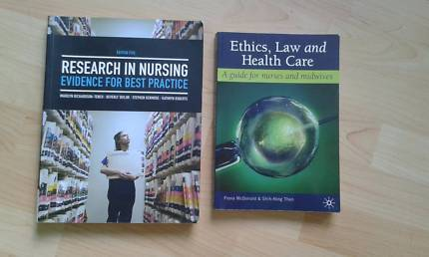
Standard 1 Practices in a manner consistent with professional and health systems values
RHNs recognise and adhere to the national legislation, laws and standards of nursing. Refugee health nursing is embedded within professional, evidence based practice, research and contemporary knowledge.
Notes:
Recognises the value of continuous education and professional reflection
1.2 Complies with policies and guidelines that have legal implications for practice.
1.3 Observes guiding policies including work health safety (WHS), child protection, domestic violence, and infection control policies
1.4 Contributes to local, state and national guidelines with independent contribution, membership of working parties and professional associations.
1.5 Recognises, understands and responds to the dynamic political environment in which refugee health is embedded
1.6 Is mindful of own practice and bias that they bring to care.
1.7 Acknowledges the risk of vicarious trauma and actively engages with relevant systems support including peer / clinical supervision

Slide 10
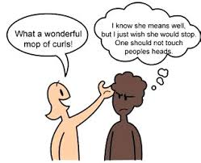
Standard 2 Communicates effectively
Effective communication is fundamental to therapeutic relationships. RHN recognise the critical role that qualified interpreters play in enabling the refugee health nurse to deliver care in everyday practice.
Notes:
Understands the past political contexts and current global events that trigger people to seek safety outside of their country of origin
2.2 Acknowledges and understands the impact of pre and post forced migration trauma, which may include torture and gender based violence on individuals lives and health
2.3 Is aware of the challenges of adjustment to life in Australia and the impact of resettlement on health and wellbeing
2.4 Aims to build trusting relationships and actively fosters a safe and therapeutic clinical environment within the framework of trauma informed care and practice
2.5 Practices within a primary health care model which acknowledges social determinants within health
2.6 Educates and orientates clients to the Australian health system
Informs clients about health rights and responsibilities including; safety, respect, communication, consent, confidentiality and mechanisms for consumer feedback.

Slide 11
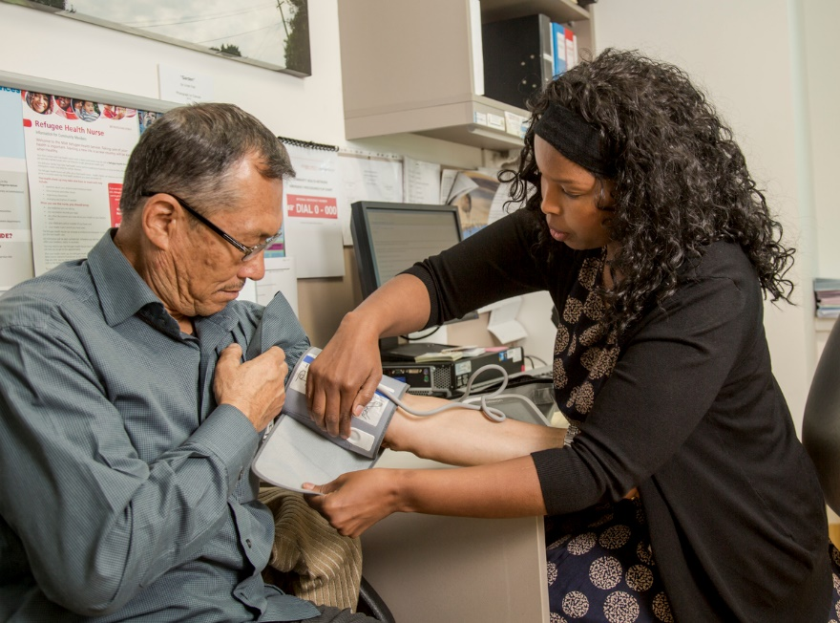
Standard 3 Provides culturally safe, and contextually informed care
RHNs are knowledgeable and informed regarding the importance of background, context and culture in the provision of services
Notes:
Performs a comprehensive health assessment
3.2 Facilitates clinical screening using evidence and a risk based approach
3.3 Undertakes psychosocial, emotional and mental health assessment utilising culturally appropriate and approved evidence based tools, guidelines and communication.
3.4 Provides oral health and hygiene assessments.
3.5 Evaluates immunisation status and provides catch up vaccination as needed
3.6 Considers and enquires about the use of traditional medicines and practices and health seeking behaviours
3.7 Enquires about the use of licit and illicit substances and provides information, support and education.
3.8 Evaluates literacy and health literacy and explores health knowledge, beliefs and health seeking behaviours.
3.9 Practices within their scope using critical thinking and an evidence base model
3.10 Utilises culturally appropriate resources related to clinical assessment
A comprehensive health assessment may include full medical history including allergies and medications, head to toe assessment including nursing observations (BP, P, T, Spo2, U/a, BSL, Height and weight, BMI), reproductive health, nutritional status, childhood development and performance of ADLs.

Slide 12
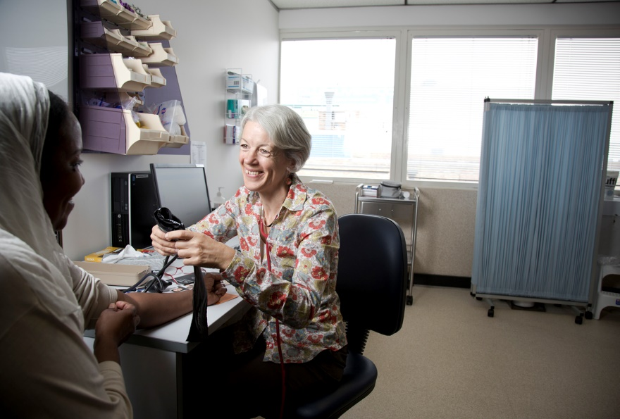
Standard 4 Conducts a comprehensive nursing assessment
Refugee health nurses conduct a comprehensive and holistic assessment utilising a culturally safe approach to care. The health assessment is conducted for individuals themselves and within the context of their family groups.
Notes:
Is knowledgeable of both mainstream and specialised refugee specific services such as torture and trauma services to facilitate optimal health outcomes
4.2 Follows up and provides ongoing support and engagement with individuals and families as required
Utilises appropriate tools and translated information for planning of care

Slide 13
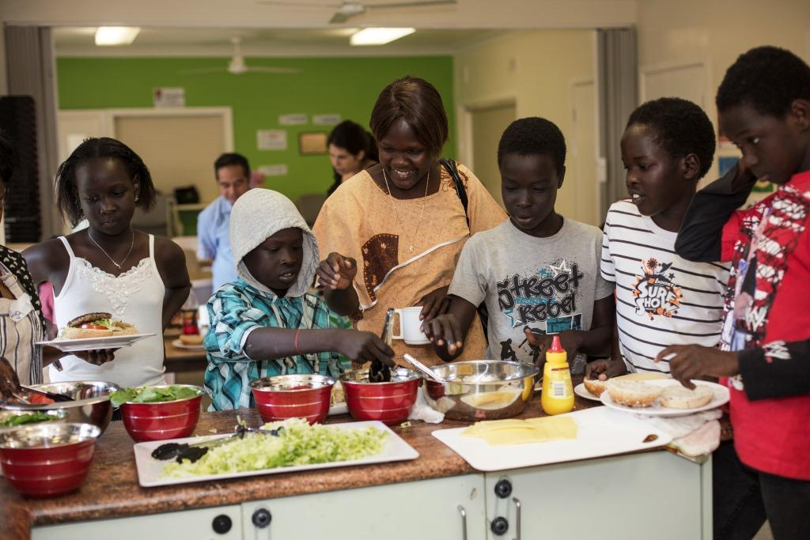
Standard 5 Effectively plans care that meets individual needs
Individual and families past experiences and length of settlement directly affects their health priorities and goals. Refugee health nurses plan ongoing care in discussion with individuals and families to help achieve long term positive health outcomes.
Notes:
Understands personal health beliefs, behaviours and biases to appreciate cultural expectations of others and facilitate health care delivery, promotion and prevention.
5.2 Advocates for the development and translation of required resources and tools
.3 Introduces individuals to the concept of preventative health screening across the lifespan
5.4 Partners with bilingual community educators as the key to facilitate community engagement and health promotion
5.5 Assesses and monitors individual, family and community learning through culturally appropriate tools

Slide 14
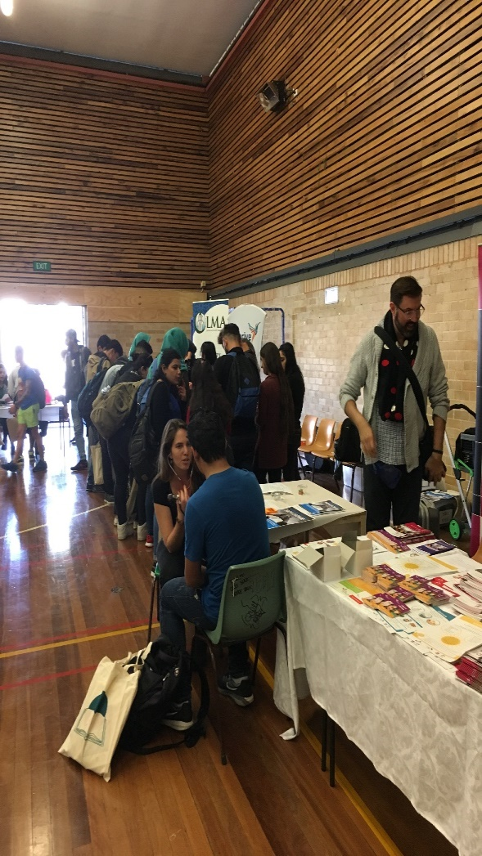
Standard 6 Actively engages in health education and promotion
The provision of health education and health promotion is embedded into refugee health nursing practice. Every activity provides opportunities to assist individuals and communities to improve their health through education and building health literacy skills
Notes:
Adheres to a strict policy of interpreter use as a right for effective communication
6.2 Demonstrates expertise in working with interpreters
6.3 Assesses and communicates effectively with clients with varying levels of health literacy
6.4 Creates a safe environment that facilitates effective communication inclusive of the interpreter
6.4 Applies understanding of dialect, age and gender as integral aspects of professional communication in the request for an interpreter.
6.5 Is aware of and assesses the risk of vicarious trauma to interpreters, and facilitates and advocates professional support services as necessary

Slide 15
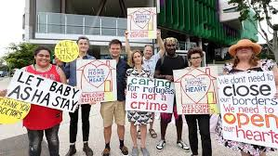
Standard 7 Advocates for equitable health access and self determination
Refugee health nurses are well placed to help shape policy and influence service delivery through their leadership and vision. Refugee health nurses acknowledge and respect the strength and resilience of people from refugee background and also recognise vulnerability and as such advocate on their behalf.
Notes:
Utilises the social determinants of health as a basic for advocacy
7.2 Clearly understands the Australian health care system. This includes limitations to access, care pathways, and the relationship between primary and tertiary care, and private and public services, right and responsibilities
7.3 Is sensitive to potential power imbalance when developing therapeutic and professional relationships.
7.4 Recognises access issues for refugees and actively works to empower and overcome access barriers
7.5 Orientates and educates individuals to the Australian health care system
7.6 Educates and builds capacity in the wider workforce which interconnects with refugee communities and refugee specific services
7.7 Provides opportunities to the undergraduate and post graduate health workforce for clinical placements

Slide 16
RNA – WHATS NEXT?
Development of professional development framework
What is the knowledge base for practice?
Qualitative and quantitative research
What are the competencies for the novice RHN?
What is advanced practice for RHN?

