Slide 1
The role of Networks in supporting regional areas
Meryl Jones – Refugee Nurses Australia
Vicky Jacobson – Refugee Health Network Qld

Slide 2
Who is arriving?
Increasing trends towards regional settlement
Australian Government response to the Joint Standing Committee on Migration report: Enabling Australia Inquiry into the Migration Treatment of Disability November 2012: From July 2012, the health waiver for humanitarian visa applicants was streamlined. Under the streamlined health waiver, a humanitarian visa processing officer will not consider any costs for health or community care services undue. This means that a health waiver can be granted more efficiently..
Welcome decision however the impact of this policy has resulted in ↑ disability which has health and support implications.
Other vulnerable groups:
Women at Risk visa category
Communities with complex needs e.g.
Yazidi – high exposure to torture/ trauma history
Emerging communities – access to interpreters

Slide 3
Challenges from a health perspective
Barriers to accessing care:
language and cultural barriers
trust
low health literacy
unfamiliarity with the Australian health system
cost of care
health professionals’ inexperience with refugee health
Presenting health issues:
infectious and parasitic disease
nutritional deficiencies
Chronic diseases
poor oral health
low levels of immunisation
Torture & trauma – mental health issues
Disability
Limited previous access to/ experience of preventative health care

Slide 4
Challenges highlighted by RNA members in regional areas
Interpreting – lack of interpreters (onsite), lack of experience/ willingness to use interpreters from “mainstream” health staff – even when interpreter use supported by local policy it is difficult to put into practice
Lack of staffing – refugee health nurses, settlement staff (often inexperienced new grads), limited staffing limits ability to flex up in response to sharp increase in arrival numbers
Lack of capacity/ skills in local health services – bulk billing GPs, specialist services, female health staff, disability services
Community views
Lack of support
Lack of locally relevant resources/ translated materials
Reduced public transport infrastructure
Isolation – services in metropolitan areas don’t understand challenges of working in regional areas

Slide 5
What RNA members find rewarding about working in regional areas
“Clients are part of the community and someone will let you know if they are falling through the cracks”
“Clients quickly become part of a community and by living and working in the same community you become a trusted member of that community also.”
“Clients have the chance of good long term outcomes due to improved housing affordability and employment options.”
“Seeing families happy and settling into their new community in spite of all they have been through in the past.”

Slide 6
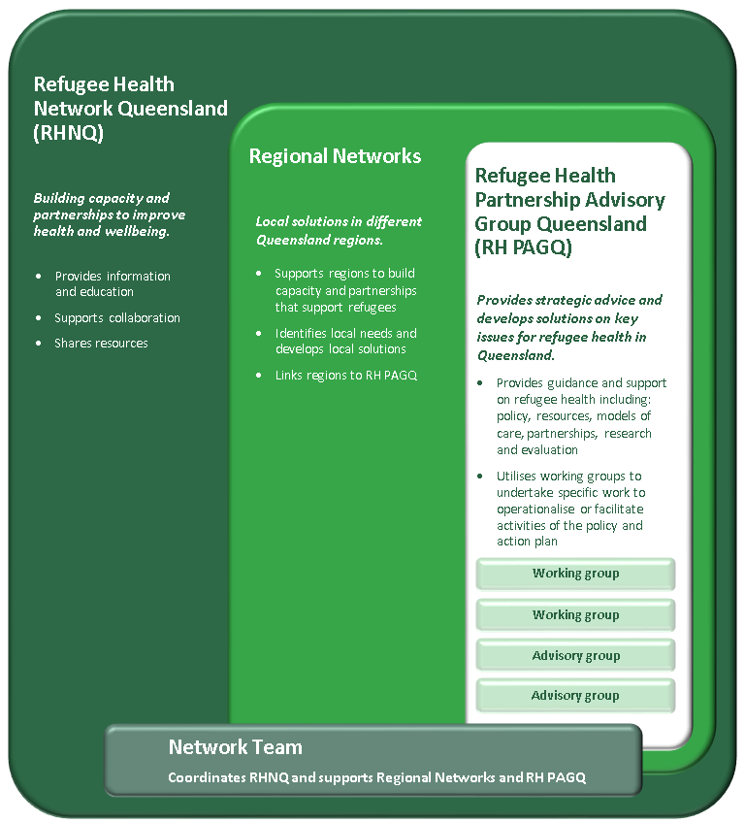
Refugee Health Network Qld (RHNQ)
Launched April 2017 with the Policy and Action Plan
Funded by QH – small network team with many partners
Strong focus on building “network of networks”
Role is to build capacity, partnerships, and facilitate coordination of care across health, settlement agencies, communities, government and non-government sectors.

Slide 7
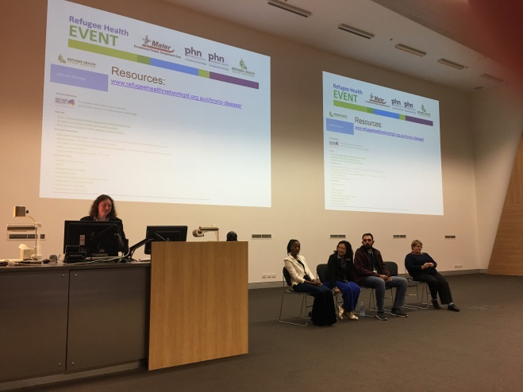
RHNQ – What we do
Development and sharing of resources
Regular communication via e-news
Advocacy & policy development on identified issues
Partnership Advisory Group, along with regional networks, working groups and advisory groups
Clinical Education

Slide 8
Why regional members value health networks
‘Connection to others – reassuring to know you are on the right track and others are doing similar things’
‘Communication about what is happening and coming up is very helpful’
‘Access to resources and support that we would not have capacity to develop by ourselves’
‘Having people you can call to thrash out ideas’
‘Knowing that you aren’t ‘on your own’’
‘Connection to the larger group to be able to influence bigger systems’

Slide 9
What more can RHNQ do in the future?
Greater outreach to regions – including provision of Clinical Support via Refugee GP Fellow
Embed more regional representation into working and advisory groups
More regular contact with regions and opportunities for face to face meetings

Slide 10
RNA – who we are
Established January 2016
National focus
There are refugee health nurses in every state and territory
Provides an opportunity for nurses working with people from a refugee background to share resources, be advocates, contribute to clinical guidelines and be involved in community of practice opportunities.
Notes:
Membership not restricted to those working specifically as refugee health nurses – open to any nurse who works with people of refugee background
Free to join – membership form on the website

Slide 11
RNA – what we do
Provide a forum for the exchange of information and resources between refugee health nurses and other relevant stakeholders across Australia.
Promote best practice in refugee health nursing through quality improvements, professional practice and evidenced based research
Provide leadership in the development of a national refugee health nurse clinical practice framework including the scope of practice, credentialing and models of care.
Advocate for refugee and asylum seeker issues.
Notes:
Achievements to date:
Just completed document outlining the scope of practice of refugee health nurse – what makes refugee health a specialist nursing area, distinct from any other primary care nurse etc
First national forum October 2017 – next March 2019
Online webinar on catch up immunisation
Website – resources
Regular emails including information about resources and training – some training is online so can be accessed by those working in regional areas
Letter from RNA exec to PM Malcolm Turnbull re cutting SRSS program for people seeking asylum

Slide 12
What RNA does to support regional workers
2/3 RNA members in regional areas felt network supports their work
Resources and education
Interstate transfer process
Connection to refugee health nurses in other services

Slide 13
What more can RNA do in the future?
Feedback on interstate transfer process
Newsletter
Increase opportunities for face to face networking
Advocate for those in rural areas
Advocate for policies affecting refugee health to be put into practice (e.g. interpreter policy)
Notes:
More feedback from interstate transfers
Newsletters
Continue to support RHNs working regionally to attend meetings/ networking/ professional development events with RHNs from other areas
Greater advocacy for refugee health workers in regional areas to leverage additional support
Advocate for government to measure service performance against policy – e.g. interpreter use

Slide 14
Thank you
Website:
www.refugeenursesaustralia.org/
Meryl Jones Nurse Unit Manager Mater Refugee Health Service
Email: mirhs@mater.org.au
Ph: 07 3163 2891
Website: www.refugeehealth networkqld.org.au/
Vicky Jacobson
Network Coordinator
Refugee Health Network Qld
Email: vicky.jacobson@mater.org.au
Ph: 07 3163 2958

