Slide 1
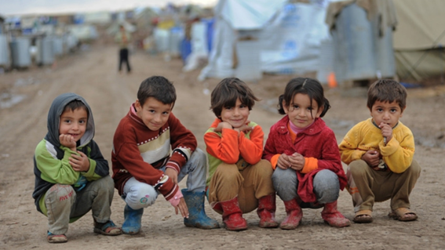
NSW REFUGEE HEALTH SERVICE Early Childhood Nurses Program Review: February- November 2017
Notes:
Hi my name is Sarah Marsh, I am one of the Early Childhood Nurses at NSW Refugee Health. Our early childhood team also includes Angii Higgins, Kylie McNulty and Susan Passey.
I am going to give an overview of our pilot program from February to November 2017.

Slide 2
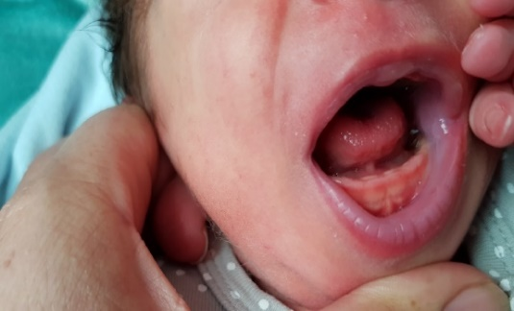
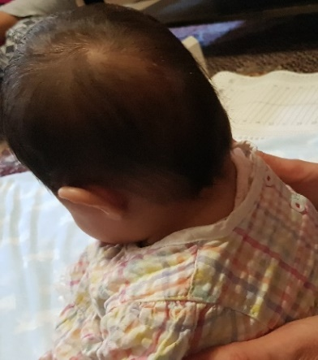
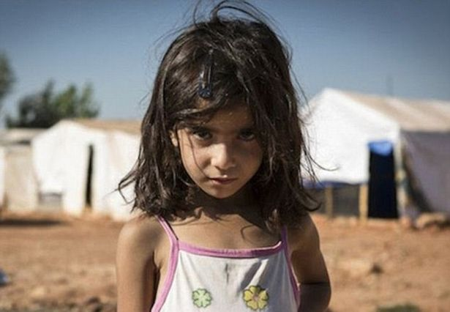
Why is an early childhood assessment important for refugees and asylum seekers?
Refugee and Asylum Seeker children = higher risk of developmental delays?
This can be due to refugee camp/detention stay; settlement process
Effect of these processes on the primary caregiver can affect attachment
Developmental delays can be overlooked
Notes:
We see women and children from Refugee and Asylum seeker background. Some have come through many detention centres and remain in community detention.
Often the mothers are very complex women with many vulnerabilities that not only impact on the development of their children but also on their own health and wellbeing. With the Asylum seekers it can be ongoing and very traumatic because they live in a state of constant uncertainty.
Delays in development are often overlooked because of the multi-complexities the family live with.

Slide 3
Barriers faced by Refugees and Asylum Seekers in accessing Early Childhood Services
Lack of awareness of what the Early Childhood Service is
Language barriers
Families unable to find or access clinics
Different nurses at clinics – affects engagement and attendance for clients
Mainstream ECHN’s may not feel knowledgeable when caring for these families

Slide 4
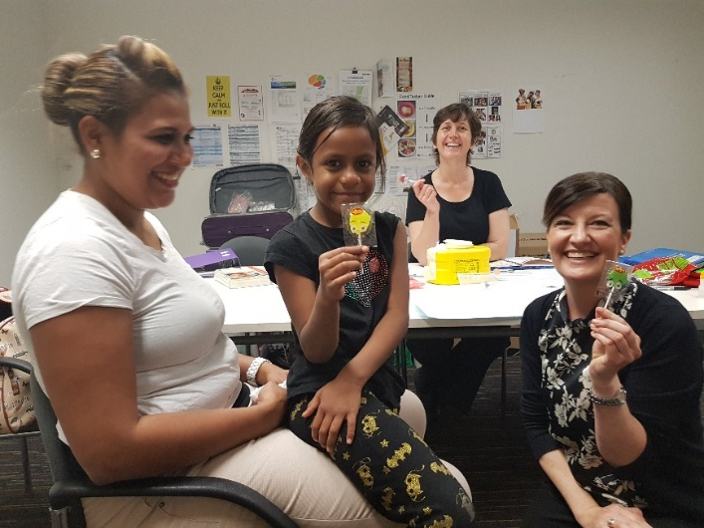
NSW RHS Early Childhood Nurses Program
Service began February 2017
Sustained home visiting service – antenatal period onwards
2.5 FTE. 0.6 included from November.
Initial primary focus was home visiting
Needs basis.
Notes:
This program arose out of a realised gap in services by the RHS, Settlement Services and local early childhood programs, who were reporting that as many as 50% of young refugee children were not being seen.
Visits can commence antenatally for pregnant clients, and are available for children not yet at school.
The RHS Early Childhood Nurses Program is a sustained home visiting program and employees 2.5 FTE Registered Nurses with a post-graduate certificate in Child and Family Health Nursing and we have another 0.6 commencing in Jan 2018.
The focus was initially on newly arrived refugees (who have arrived in the preceding 12 months) and works on a referral system, although there are instances of self-referral of families who have heard about the program. Over the time the program has been going it has progressed into a combination of home visiting, 4yr developmental clinics, blue book low risk clinics and a vaccination clinic for asylum seekers.
Initially started as a home visiting program, however it has now moved into a combination of home visiting, a full 4yr clinic including hearing and vision, a low risk clinic, we attend playgroups and two of our nurses Kylie McNulty and Angii Higgins recognised a need for a vaccination clinic for children who do not have access to medicare.
We have a strengths-based approach, working in partnership with the mothers to empower their parenting skills; assess their child’s development; provide practical skills they can use with their child; and refer them to other services as needed.
Home visits can continue for as long as the child and family need them, prior to the child commencing at school. The initial idea of the program was to see the clients twice and refer onto mainstream CFH services, however the clients are not attending these appointments we have made and we have identified the need for blue book low risk clinics. This will commence in Jan 2018. We will be collecting data on attendance and referrals.

Slide 5
Client Country of Birth
COUNTRY OF BIRTH | NUMBER
IRAQ | 105
SYRIA | 36
AUSTRALIA | 10
IRAN | 8
CHINA | 7
FIJI | 7
AFGHANISTAN | 5
PAKISTAN | 5
PHILIPINES | 3
TURKEY | 3
NIGERIA | 3
TONGA | 3
CONGO | 2
INDIA | 2
INDONESIA | 2
LEBANON | 2
PNG | 2
SRI LANKA | 2
UGANDA | 2
Notes:
The main COB is Iraq. Followed by Syria.
Its interesting to see the next largest group were born in Australia. Their parents were born in a variety of countries and from this data being Feb to Nov these children are asylum seekers.

Slide 6
Visa Types
Notes:
35% have a 202 Visa
31% have a 200 Visa
1% have a 204 Visa
32% of the clients we see hold a variety of visas that do not allow them access to Medicare or limited medical services.
These include Asylum Seekers who hold a bridging visa, protection visa, student visa, skilled visa.

Slide 7
Where are our referrals coming from?
Notes:
The largest amount of referrals we have are from the RHN program.
Once this influx settled down we found a large majority of our referrals come from Settlement services such as SSI, LWB and the Red Cross
As the service is becoming more well known we are getting referrals from different area health services and NGO’s

Slide 8
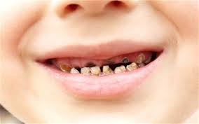
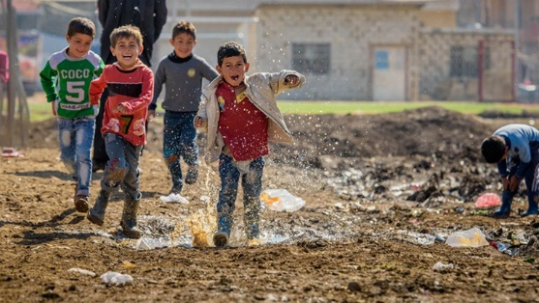
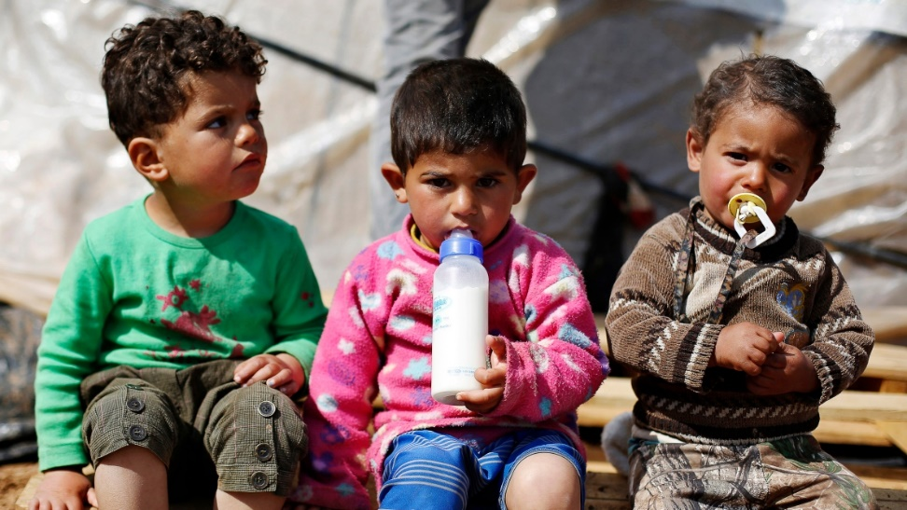
Issues Emerging…..
Delays in fine motor skills
Delays in language development
Prevalence of tooth decay
Multiple psychosocial issues related to history of trauma and lack of financial assistance
Notes:
At this stage the main delays include fine motor and speech. Sometimes we find just identifying the issue with the parents and providing them with information, education and activities improves the delay. Other times we refer onto tertiary services as needed.
The prevalence of tooth decay in the refugee children is high. The RHN program also check the teeth and provide education. We find that by the time we see them they have had referrals to ECOH. From our data we can see that clients born in Iraq were over-represented in this group – decay was present in 44.11% Iraqi children checked.
We find in this population soft drinks, lollies, cakes etc are given frequently to the children and dental hygiene knowledge is low. Its not unusual to see a 3 to 4yr old child who is not brushing their teeth on a regular basis. I have talked to mothers who have never provided any dental hygiene to a 2yr old child. We provide them with evidence based education in regards to dental hygiene from a very young age.
Psychosocial issues can include depression/anxiety/homelessness/lack of food/inability to pay bills or provide for their children.

Slide 9
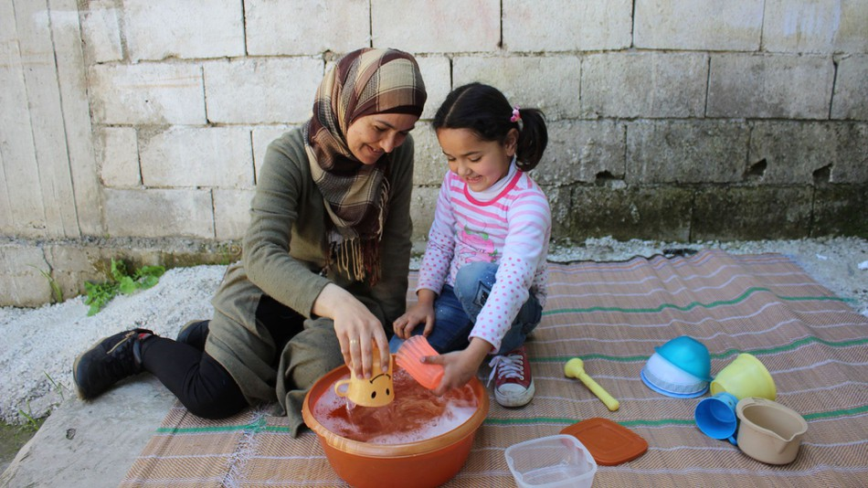
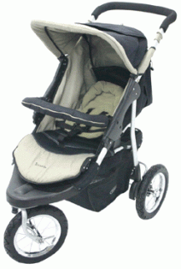
How to address these issues?
Simple interventions prior to commencing school work well
Empowering parents as teachers is an effective way to deliver the interventions
If intervention is not successful, then a referral can be initiated
Providing material needs for the family (courtesy of Dandelion Services) toys, clothing, books, cots, and prams to vulnerable families.

Slide 10
How to address these issues? (Cont)
Provide ongoing support to families ensuring referrals have been accepted
Advocating for the women in the community
Building partnerships within the community to ensure better clinical and referral pathways for families
Early Childhood Nurses continue to work within the large multidisciplinary team in Refugee Health which includes the GP Clinic Nurses, RHNs, RH Social Worker, and the RHS Disability Team.
Early Childhood Nurses continue with interagency collaboration
Notes:
It is essential that we are Early Childhood nurses focus on building partnerships in the community to ensure easy access for our families into services they need.

Slide 11
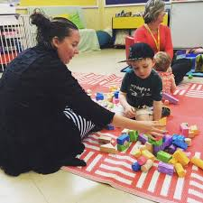
Referral Pathways
Oral health
Vision
Hearing
Speech
Occupational Therapy
Women’s Health
Supported playgroups/Mother’s groups
Mental health/counselling
RHS clinics (GP Program, Immunisation, 4yo clinics)
Nutrition/Dietetics
Asylum seeker support services
Charities
Mainstream Child & Family Health services
Notes:
Our data collection remains an ongoing work in progress. What we are seeing is an extraordinary amount of referrals being made. These services include all of the above.
We have made over 200 referrals. These include referrals for the children and the mothers.

Slide 12
Further Research Opportunities
Qualitative Research
Have all barriers to accessing services been dealt with?
Do parents feel supported and empowered by this program?
What further can be done to help refugee families raise their children?
Quantitative Research
Further demographic research
Do developmental delays occur at a higher rate in refugee populations?
What difference in outcomes can be seen at school?
Notes:
Quantative and qualitative research into this program will be important to confirm findings and insure that appropriate, and best care is being provided. Some example could include:
Have all barriers to accessing services been considered? For instance how easy do parents find it to confirm or change appointment times?
There is lots of research which states parents can find it difficult to raise children when they are not in their home country – do parents feel that this program helps to overcome that?
Do families feel that the scope of the program is appropriate – what do clients think is missing?
Quantative research could be incorporated into the data collection that already occurs, making data easier to access. Examples include:
Further demographic research, for example the time between arrival in Australia and initial visits
Do development delays occur at higher rates in refugee populations?
We will collect data in regards o the vaccination clinic, the PHR clinics including attendance/DNAs – are they working versus home visiting?

Slide 13
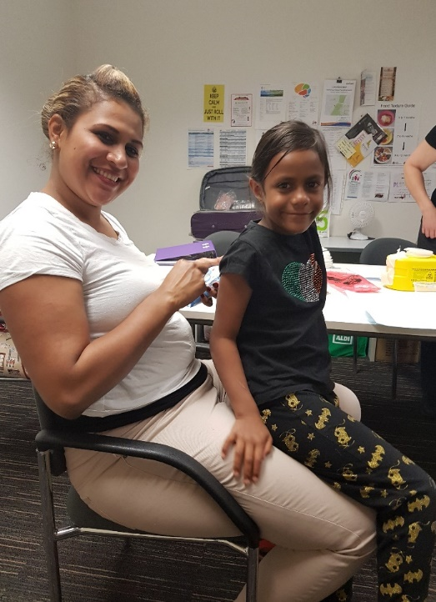
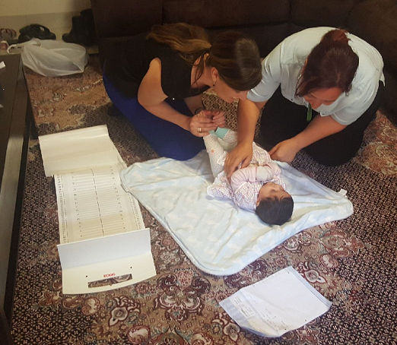
Conclusion
This is an evidence-based service that overcomes barriers to provide treatment for an at-risk population
Our program could potentially provide a blueprint for Nationwide refugee/Asylum seeker specific early childhood services
Further research is important

Slide 14
Questions?

